Slide 1

Linear Discriminant Analysis

Slide 2
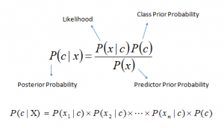
Naive Bayes Again
In Naive Bayes and in the examples yesterday, we and calculated P(Y|X) directly by finding the count of occurences.
In Linear Discriminant Analysis, we will first estimate P(X|Y) by assuming some distribution and then use Bayes theorem to flip these estimates into estimates of P(Y|X).
Remember, Bayes’s theorem is

Slide 3
Naive Bayes Again
The primary difference with LDA and GaussianNB is that while both classifiers assume Gaussian within-class distributions, NB assumes a Gaussian distribution with zero covariance (variable independence)
LDA relaxes this assumption and considers co-variance between features.
If the variables are independent, Pearson's correlation coefficient is 0, but the converse is not true. 0 correlation also implies a zero covariance.
So by considering a covariance matrix, independence is not assumed.
Recall the definition of Covariance:
Cov(X₁,X₂) = ∑ (x_{i1}-x_{1avg})(x_{i2}- x_{2avg})/(# of observations)

Slide 4

LDA with only 1 predictor X₁
P(X|Y) asks the question: Given the class, what is the distribution of the inputs? To phrase this another way, given a class, what is the probability of observing a particular data point from X₁
To answer this, we can assume that the likelihood come from a normal distribution (same as GaussianNB) This is the density function of a normal distribution.
With this assumption, P(X|Y) now is equal to the above and μ_{k} and σ_{k}² are the mean and variance parameters for the kth class.

Slide 5

Continued...
For now, we make a simple assumption that σ₁² = . . . = σ_{K}² : that is, there is a shared variance term across all K classes, which for simplicity we can denote by σ².
If we plug this equation back into the Bayes’ theorem, take the log of the theorem and rearrange the terms we get
So, what we did was take the mean of the X₁ values per class, assumed a common variance among all classes and then we assigning the observation to the class for which the above equation is the largest. The last term there is simply the class prior P(Y).

Slide 6
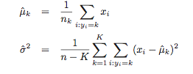
Continued
The mean and the variance before are calculated using
where n is the total number of training observations, and nk is the number of training observations in the kth class. The estimate for μ_{k} is simply the average of all the training observations from the kth class, while σˆ² can be seen as a weighted average of the sample variances for each of the K classes.

Slide 7
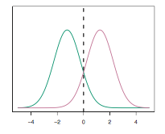
The LDA Decision Boundary
Once we have computed the means and the variance, we now have the normal distributions we seeked at the beginning.
In the above image, for our 1 predictor and K = 2 classes, we now have 2 normal distributions from which different probabilities of X₁ are observed.
Here we have set the class priors to 0.5 and we can see that if x<0 the observation belongs to one class and if x>0 it belongs to the other.

Slide 8
LDA
To reiterate, the LDA classifier results from assuming that the observations within each class come from a normal distribution with a class-specific mean vector and a common variance σ², and plugging estimates for these parameters into the Bayes classifier.
The term linear in LDA, then, refers to the fact that this method can only compute a linear separator and not one of a more complex shape. The term discriminant comes from the fact the two normal distribution functions help us discriminate between classes.

Slide 9
LDA with more than 1 predictor
In the case of 1 predictor, we could assume a common variance however as we increase our predictors this assumption is unrealistic.
With more predictors, we have to compute the class-specific variance, σ_{k}² for the observations of a certain feature belonging to a certain class.
To do this we assume that (X1,X2,...,Xp) is drawn from a multivariate normal distribution. The multivariate normal distribution assumes that there is some correlation between each pair of predictors (UNLIKE NAIVE BAYES)

Slide 10
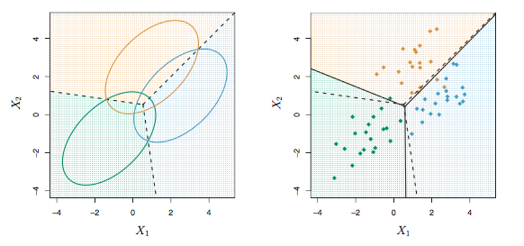
LDA with 3 classes and 2 predictors
- Here we see that LDA that three decision boundries have been created.

Slide 11
Quadratic Discriminant Analysis
LDA assumes that the observations within each class are drawn from a multivariate Gaussian distribution with a class- specific mean vector and a covariance matrix that is common to all K classes.
To indicate that a p-dimensional random variable X has a multivariate Gaussian distribution, we wrote X ∼ N(μ,Σ). Here E(X) = μ is the mean of X (a vector with p components), and Cov(X) = Σ is the p × p covariance matrix of X.
In QDA, it assumes that an observation from the kth class is of the form X ∼ N(μ_{k},Σ_{k}), where Σ_{k} is a covariance matrix for the kth class.

Slide 12

So what’s the big deal?
Why does it matter whether or not we assume that the K classes share a common covariance matrix? Again, let's look at this through the Bias-Variance Tradeoff.
By assuming a shared variance, LDA produces a linear decision boundary as K(classes)*p(predictors) linear coefficients have to be predicted.
For this our decision rule was :
When we no longer share variance terms, we get:

Slide 13
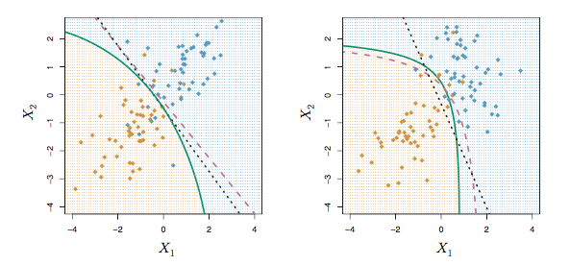
QDA (green line) vs. LDA (black dashed line)
That QDA decision rule (and boundry) is quadratic in nature (which is where QDA gets is name).

Slide 14
Lets take a practical example,
Curvature | Diameter | Quality
2.95 | 6.63 | Passed
2.53 | 7.79 | Passed
3.57 | 5.65 | Passed
3.16 | 5.47 | Passed
2.58 | 4.46 | Not Passed
2.16 | 6.22 | Not Passed
3.27 | 3.52 | Not Passed
We get a new chip, with curvature 2.81 and diameter 5.46, will it pass?

Slide 15
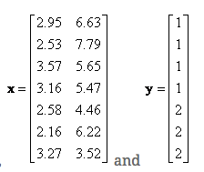
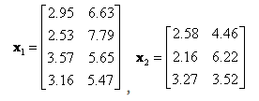


LDA Computation

Slide 16




Calculating LDA
Within class scatter is,
Or in vector form
Weighted between class scatter is
So, now we have all the parts to maximize J(W) by taking the Matrix derivative and setting J(W) to 0.

Slide 17
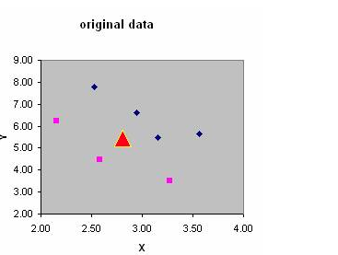
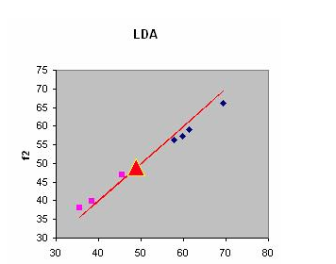
LOOK!
Notes:
To make a prediction, we would get the pooled covariance (weighted sum of added covariances), the class priors and input them into the discriminant function. We would assign observation i to the class j for which the discriminant function is largest.

Slide 18
QDA vs. LDA
Since LDA is linear it is a much less flexible classifier than QDA, and so has substantially lower variance. This can potentially lead to improved prediction performance.
However, if the assumption of shared variance and therefore the assumption that the data can be separated by a linear decision boundry is off, QDA is better.
Roughly speaking, LDA tends to be a better bet than QDA if there are relatively few training observations and so reducing variance is crucial. In contrast, QDA is recommended if the training set is very large, so that the variance of the classifier is not a major concern, or if the assumption of a common covariance matrix for the K classes is clearly unviable.

